Slide 1


Introduction to Library Management System project
A Library Management System (LMS) is an essential software for managing all the processes of a library. It enables librarians to keep track of items in the library, manage borrower information, and facilitate book transactions.

Slide 2


OverView of C Language
Foundational Language
Linked Lists in Project
The C programming language is a foundational language in the world of computer programming, known for its efficiency and power. It's widely used in system software, embedded systems, and more.
Linked lists, a fundamental data structure in C, are used to manage dynamic memory allocation in the Library Management System project. They allow flexible storage and retrieval of data.

Slide 3
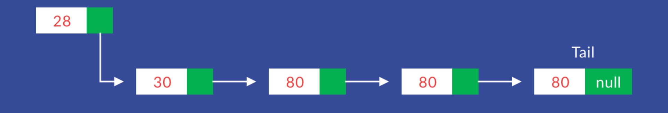
Significance of Using Linked Lists in the Project
Dynamic Data Storage
Memory Flexibility
Enhanced Performance
Linked lists provide efficient management of dynamically changing data in the library system, enabling easy addition, deletion, and traversal of data elements.
With linked lists, memory allocation is more flexible, enabling the system to accommodate varying sizes of book records and borrower information.
By using linked lists, the Library Management System can efficiently handle a large number of records and transactions, thereby improving overall system performance.

Slide 4

Features and Functionalities
1
Add Book
2
Submit Book
Enables librarians to easily add new books to the library inventory, with details like title, author, and categories.
Allows borrowers to return books through the system, updating the availability status and managing fine calculations.
3
Issue Book
Facilitates the process of issuing books to borrowers, managing due dates and holding information.

Slide 5
Feature Details
1. Add Book
2. Issue Book
3. Search Book
Description: Allows users to add new books to the library database.
Description: Allows users to check out books from the library.
Description: Facilitates users in searching for specific books in the library.
Implementation: Utilizes linked lists to dynamically manage book records, ensuring efficient memory usage.
Implementation: Modifies the linked list to mark the book as "issued" and records relevant details.
Implementation: Implements linked list traversal to find and display matching book records.
User Interaction: Requests user input for the book to be issued and borrower details.
User Interaction: Prompts the user to input book details such as title, author, and ISBN.
User Interaction: Prompts the user to input search criteria like title, author, or ISBN.

Slide 6

User Interface and Navigation
1
Intuitive Interface
The LMS features a user-friendly interface, simplifying the browsing, searching, and transaction processes.
2
Navigation Efficiencies
Efficiently designed navigation enables smooth movement between different sections and tasks within the library management system.

Slide 7

Challenges Faced
1
Data Integrity
2
User Authentication
Maintaining high data integrity with linked lists and dynamic memory allocation required meticulous handling.
Implementing secure and user-friendly authentication processes was a significant challenge in user management.
3
Performance Optimization
Ensuring high-performance levels while managing a large database of books and borrowers was a persistent challenge.

Slide 8




Lessons Learned
Software Design
User Feedback
Data Management
The project emphasized the importance of robust software design principles for scalability and maintainability.
Understanding user feedback played a crucial role in refining the user interface and enhancing the overall system experience.
Efficient data management techniques were crucial for addressing the linked list-related challenges and ensuring system stability.

Slide 9

Conclusion and Future Enhancements
In conclusion, the Library Management System project has provided valuable insights into the complex processes of library administration and user interaction. Moving forward, future enhancements will focus on leveraging advanced algorithms for data management, implementing AI-based recommendation systems, and enhancing mobile compatibility for the LMS platform.

Slide 10
THANK YOU
BY PIYUSH RAJ
2200290100114

